Slide 1

SECD2523 DATABASE
TOPIC 8 | INTRODUCTION TO DATA WAREHOUSE
Content adapted from Connolly, T., Begg, C., 2015. Database Systems: A Practical Approach to Design, Implementation, and Management, Global Edition. Pearson Education.

Slide 2
LECTURE LEARNING OUTCOME
By the end of this lecture, students should be able to:
01
The main concepts and benefits associated with data warehousing.
02
How online transaction processing (OLTP) systems differ from a data warehouse.
03
The problems associated with data warehousing.
04
The architecture and main components of a data warehouse.
05
The concept of a data mart and the main reasons for implementing a data mart.

Slide 3
What is Data Warehouse?
Data warehouse (DW) is an environment, not a product.
Data is often scattered across different database, it need DW to get complete information.
It is aimed at effective integration of operational databases that enables strategic use of data.

Slide 4
Definition: Data Warehouse
“A subject-oriented, integrated, time-variant, and non-volatile collection of data in support of management’s decision-making process.” (W. H. Inmon, 1993)
“A data warehouse is a single, complete and consistent store of data obtained from a variety of sources and made available to end users in a way they can understand and use in a business context.”
“A data warehouse is a collection of corporate information derived directly from operational systems and some external data sources.”

Slide 5
Data Warehousing - Introduction
Data warehousing integrates data and information collected from various sources into one comprehensive database.
  (e.g. Customer information from organization’s point-of-sale systems, its mailing lists, website and comment cards, etc.)
Data warehouse is a centralized storage system or central repository for storing, analyzing information and interpreting of data in order to facilitate better decision making.
A data warehouse is a type of data management system that facilitates and supports business intelligence (BI) activities, specifically analysis.
It is primarily designed to facilitate searches and analyses usually contain large amounts of historical data.

Slide 6
Data Warehouse Usage - Examples
Investment & Insurance Companies – to analyze customer & market trends and allied data patterns.
Retail Chains – used for marketing and distribution to tract items, examine pricing policies and analyze buying trends of customers.
Healthcare – to generate treatment reports, share data with insurance companies & medical units.
Airline – operation purpose like crew assignment, route profitability, frequent flyer program promotions, etc.
Banking – to manage resources available on desk effectively.
Public Sector – used for intelligence gathering, to maintain & analyze tax records, health policy records, etc.
Telecommunication – used for product promotions, sales decisions and to make distribution decisions.

Slide 7
Concepts of Data Warehousing
Data Integration: Combines data from various sources into a unified repository.
Historical Data Storage: Stores data over time, allowing for trend analysis.
Analytical Processing: Designed for complex queries, data mining, and reporting.

Slide 8
Benefits of Data Warehousing
Successful implementation of data warehouse can bring major benefits to an organization:
Improved Decision Making: Provides a single, reliable source of data for analytics and reporting.
Enhanced Data Quality and Consistency: Centralized data management ensures data is cleansed, validated, and standardized.
High Performance for Queries: Optimized for complex queries and large-scale data analysis, improving response times.
Historical Data Analysis: Enables long-term trend analysis and supports strategic decision-making.
Better Data Management: Simplifies data management by consolidating multiple data sources into one location.

Slide 9
Characteristics of data in DW
The data held in a data warehouse is described as being subject-oriented, integrated,
time-variant, and nonvolatile (Inmon, 1993).
Subject-oriented
Integrated
Time-variant
Non-volatile
The warehouse is organized around the major subjects of the enterprise (e.g. customers, products, and sales) rather than the major application areas (e.g. customer invoicing, stock control, and product sales).
This is reflected in the need to store decision-support data rather than application-oriented data.
The data warehouse integrates corporate application-oriented data from different source systems, which often includes data that is inconsistent.
The integrated data source must be made consistent to present a unified view of the data to the users.
Data in the warehouse is only accurate and valid at some point in time or over some time interval.
Time-variance is also shown in the extended time that the data is held, the implicit or explicit association of time with all data, and the fact that the data represents a series of snapshots.
Data in the warehouse is not normally updated in real-time (RT) but is refreshed from operational systems on a regular basis. (However, emerging trend is towards R T or near RT DWs)
New data is always added as a supplement to the database, rather than a replacement.
Notes:
Subject – oriented:
Focusing on the modeling and analysis of data for decision makers, not on daily operations or transaction processing.
Provide a simple and concise view around particular subject issues by excluding data that are not useful in the decision support process.
Integrated:
Constructed by integrating multiple, heterogeneous data sources.
Relational databases, flat files, on-line transaction records.
Data cleaning and data integration techniques are applied.
Ensure consistency in naming conventions, encoding structures, attribute measures, etc among different data sources (e.g. Hotel price: currency, tax, breakfast covered, etc.)
When data is moved to the warehouse, it is converted.
Time Variant:
The time horizon for the data warehouse is significantly longer than that of operational systems.
Operational database: current value data.
Data warehouse data: provide information from a historical perspective (e.g., past 5 – 10 years).
Every key structure in the data warehouse.
Contains an element of time, explicitly or implicity.
But the key of operational data may or may not contain “time element”.
Non-Volatile:
A physically separate store of data transformed from the operational environment.
Operational update of data does not occur in the data warehouse environment.
Does not require transaction processing, recovery, and concurrency control mechanisms.
Requires only two operations in data accessing:
Initial loading of data and access of data.

Slide 10
Design of Architecture of a Data Warehouse
Designed for analytical processing.
Optimized for complex queries, data aggregation and large-scale reporting.
Focuses on historical data and trends.
A consolidated/integrated view of corporate data drawn from disparate operational data sources and a range of end-user access tools capable of supporting simple to highly complex queries to support decision making.

Slide 11
Architecture Components of a Data Warehouse
Data Sources: Include internal databases (OLTP systems), external data sources, and other data feeds.
ETL (Extract, Transform, Load) Process:
  Extracts: Gather data from various sources,
  Transform: Converts data into a usable format, ensuring consistency and accuracy.
  Load: Loads transformed data into the data warehouse.
Data Storage: Centralized storage area for structured and unstructured data, often using a star or snowflake schema for organizing data.

Slide 12
Architecture Components of a Data Warehouse (cont.)
Data Marts: Subsets of the data warehouse, optimized for specific departments or business functions.
Metadata Management: Manages metadata, which describes the structure, operations, and contents of the data warehouse.
Data Access Tools: Include reporting, analysis, data mining, and visualization tools for end-users.

Slide 13
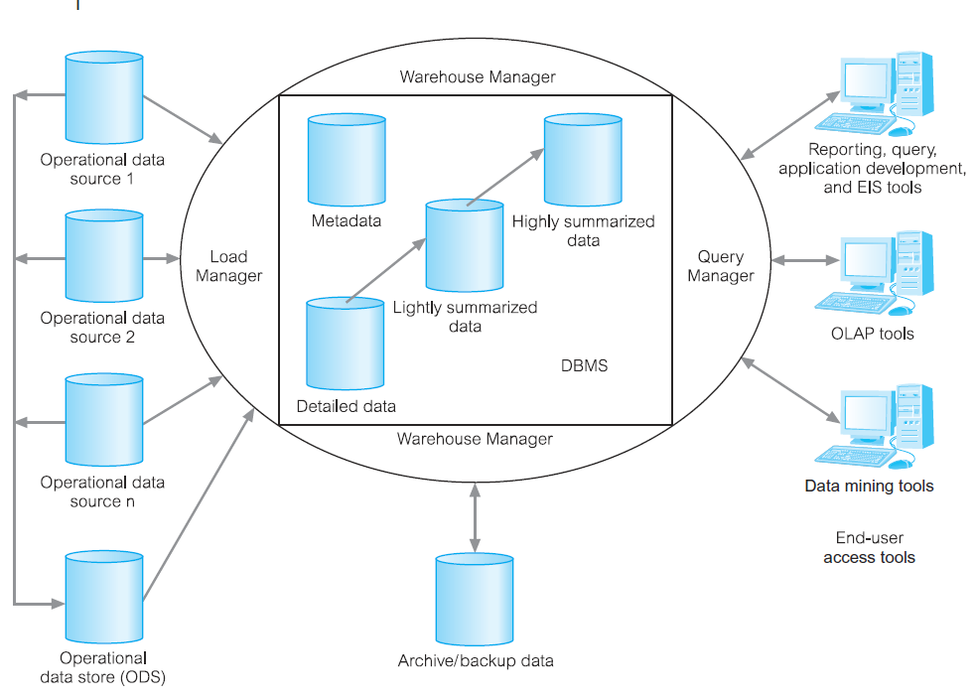
Data Warehouse Architecture
The typical architecture of a data warehouse

Slide 14
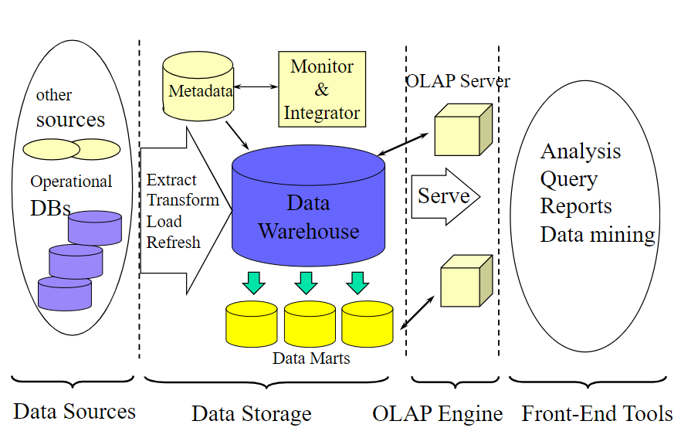
Multi-Tiered Architecture of Data Warehouse

Slide 15
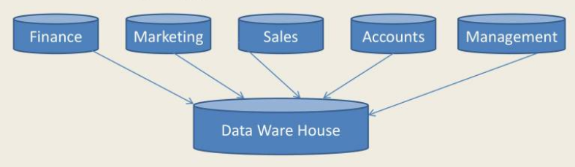
Designing a Data Warehouse
Bottom-Up Approach
The Bottom-Up Approach creating small data marts, to solve specific business problems.
As these data marts can be combined into a larger data warehouse.

Slide 16
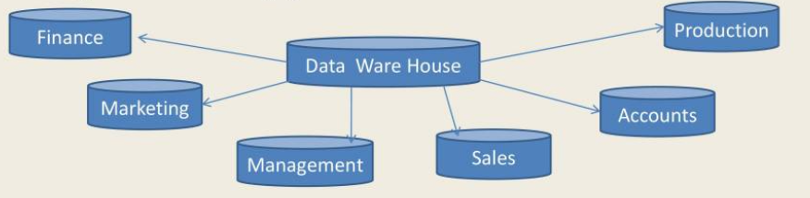
Designing a Data Warehouse
Top-Down Approach
The Top-Down Approach suggests that start by creating an enterprise-wide data warehouse and then, as specific business needs are identified, create smaller data marts.

Slide 17
Data Mart
A database that contains a subset of corporate data to support the analytical requirements of a particular business unit (such as the Sales department) or to support users who share the same requirements to analyse a particular business process (such as property sales).
A smaller, more focused version of a data warehouse tailored to specific business areas (e.g., sales, finance).

Slide 18
Reasons for Creating a Data Mart
Improved Performance: Faster query response times for specific data sets.
Cost Efficiency: Reduces storage and processing costs by focusing on specific data needs.
Simplified Access: Makes data access easier and more relevant for end-users (give users access to the data they need to analyze most often).
Customized data models for specific business requirements (to provide data in a form that matches the collective view of the data by a group of users in a department or business application area).

Slide 19
Designing a Data Warehouse
Dimensionality Modeling:
A logical design technique that aims to present the data in a standard, intuitive form that allows for high-performance access.
Two types in general:
  Star schema
  Snowflake schema
Fact Table – the primary table in a dimensional model that is meant to contain measurements of the business.
Dimension Table – One of a set of companion tables to a fact table. Most dimension tables contain many textual attributes that are the basis for constraining and grouping within data warehouse queries.

Slide 20
Dimensionality Modeling
Dimension tables usually contain descriptive textual information.
Dimension attributes are used as the constraints in data warehouse queries.
Every dimensional model (DM) is composed of one table with a composite primary key, called the fact table, and a set of smaller tables called dimension tables.

Slide 21
Dimensionality Modeling (cont.)
Star schema is a logical structure that has a fact table containing factual data in the center, surrounded by dimension tables containing reference data, which can be denormalized.
Star schemas can be used to speed up query performance by denormalizing reference information into a single dimension table.
Snowflake schema is a variant of the star schema that has a fact table in the center, surrounded by normalized dimension tables.
Starflake schema is a hybrid structure that contains a mixture of star (denormalized) and snowflake (normalized) dimension tables. Allows dimensions to be present in both forms to cater for different query requirements.

Slide 22
Star Schema
A dimensional data model that has a fact table in the center, surrounded by denormalized dimension tables.
A fact table in the middle connected to be a set of dimension tables.
Star schema is a logical structure that has a fact table (containing factual data) in the center, surrounded by denormalized dimension tables (containing reference data).
Facts are generated by events that occurred in the past, and are unlikely to change, regardless of how they are analyzed.
Notes:
- Central fact table connected to multiple dimension tables.
- Simpler design, faster query performance due to denormalization.

Slide 23
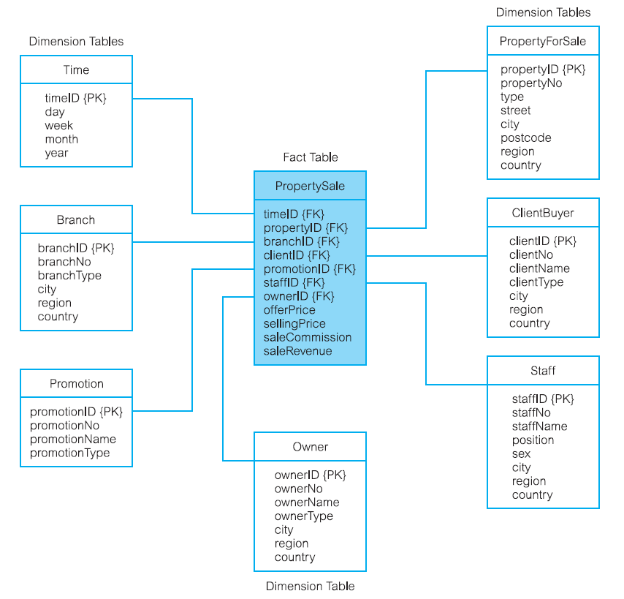
Example of Star Schema

Slide 24
Snowflake Schema
A dimensional data model that has a fact table in the center, surrounded by normalized dimension tables.
A refinement of star schema where some dimensional hierarchy is normalized into a set of smaller dimension tables, forming a shape similar to snowflake.
Bulk of data in data warehouse is in fact tables, which can be extremely large.
Important to treat fact data as read-only reference data that will not change over time.
Most useful fact tables contain one or more numerical measures, or ‘facts’ that occur for each record and are numeric and additive.
Notes:
Central fact table connected to normalized dimension tables with sub-dimensions.
- Reduced data - redundancy, improved data integrity, but more complex design and potentially slower queries due to more joins.

Slide 25
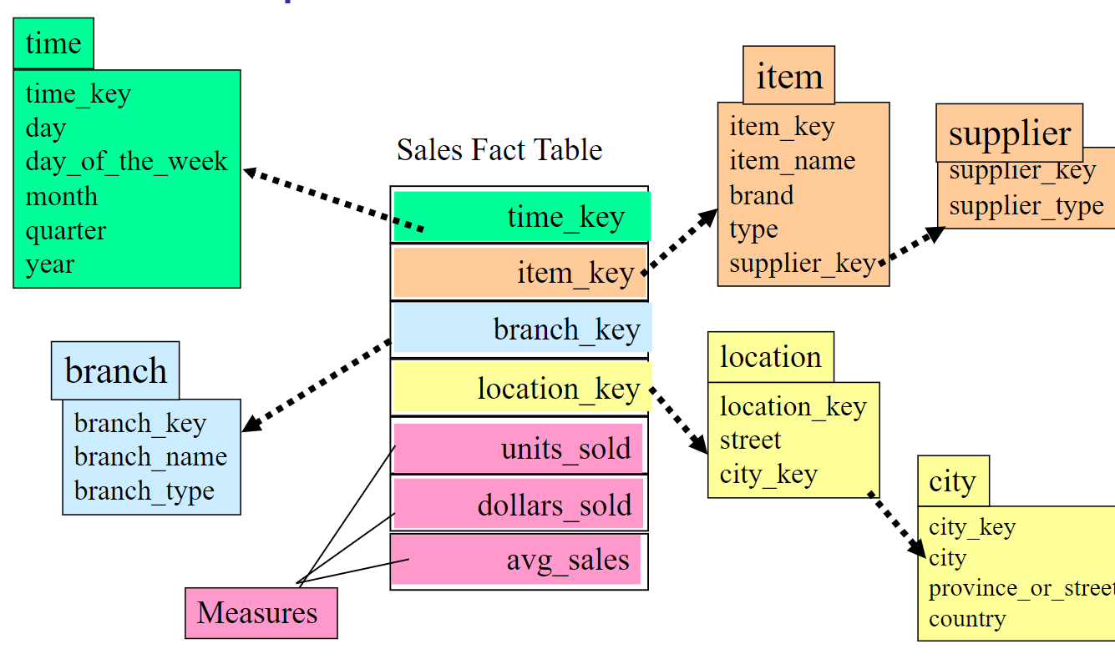
Example of Snowflake Schema (1)

Slide 26
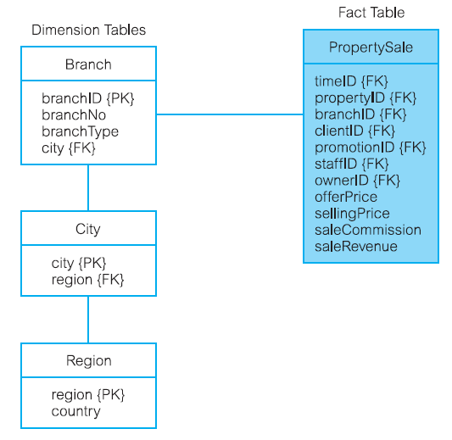
Example of Snowflake Schema (2)

Slide 27
Online Transaction Processing (OLTP)
Major task of traditional relational DBMS.
Design for day-to-day transaction processing: purchasing, inventory, banking, manufacturing, payroll, registration, accounting, etc.
Optimized for data entry, updating and deletion.
Focuses on real-time data management.
Notes:
* An OLTP or operational system is used to deal with the everyday running of one aspect of an enterprise.

Slide 28
Online Analytical Processing (OLAP)
Original definition - The dynamic synthesis, analysis, and consolidation of large volumes of multi-dimensional data, Codd (1993).
Describes a technology that is designed to optimize the storing and querying of large volumes of multi-dimensional data that is aggregated (summarized) to various levels of detail to support the analysis of this data.
Enables users to gain a deeper understanding and knowledge about various aspects of their corporate data through fast, consistent, interactive access to a wide variety of possible views of the data.
Allows users to view corporate data in such a way that it is a better model of the true dimensionality of the enterprise.

Slide 29
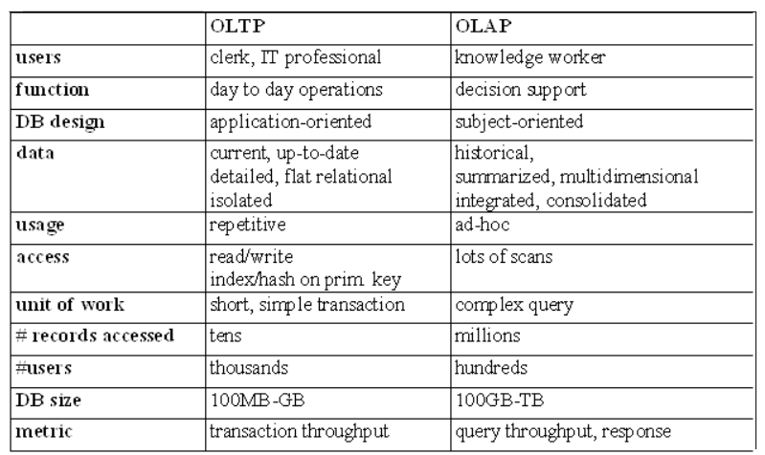
OLTP vs. OLAP

Slide 30
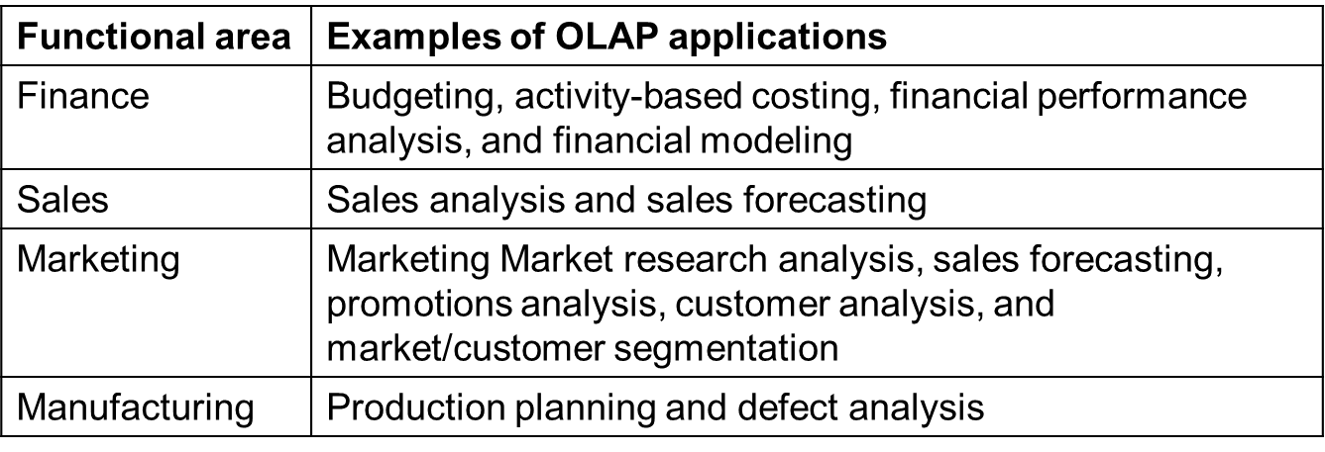
Examples of OLAP Applications in Various Functional Areas

Slide 31
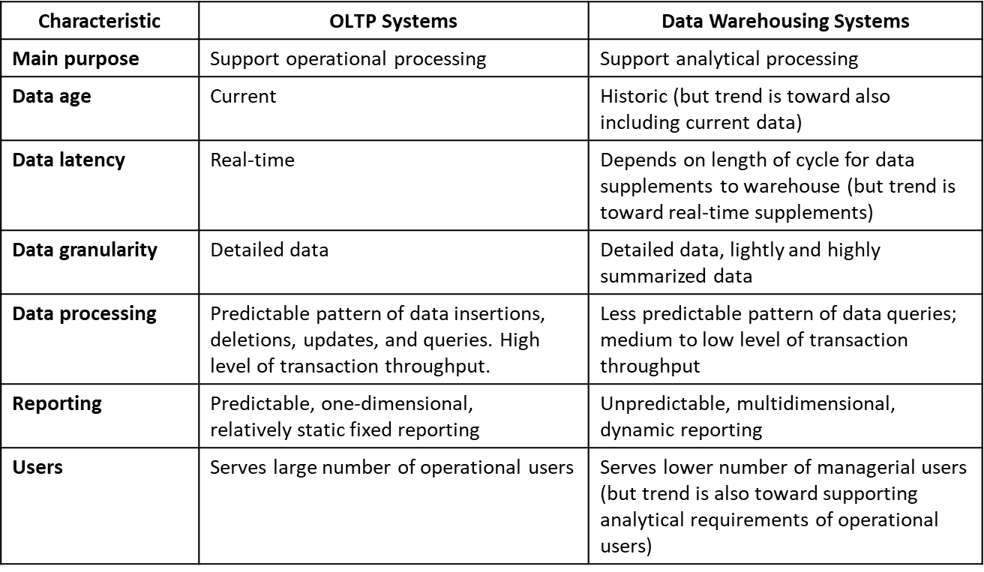
Comparison of OLTP Systems and Data Warehousing
A DBMS built for online transaction processing (OLTP) is generally regarded as unsuitable for data warehousing, because each system is designed with a differing set of requirements in mind.
For example, OLTP systems are designed to maximize the transaction processing capacity, while data warehouses are designed to support ad hoc query processing.

Slide 32
Data Warehouse Queries
The types of queries that a data warehouse is expected to answer ranges from the relatively simple to the highly complex and is dependent on the type of end-user access tools used.
End-user access tools include:
  Traditional reporting and query
  O L A P
  Data mining

Slide 33
Example - Data Warehouse Queries
What was the total revenue for Scotland in the third quarter of 2001?
What was the total revenue for property sales for each type of property in Great Britain in 2000?
What are the three most popular areas in each city for the renting of property in 2001 and how does this compare with the figures for the previous two years?
What is the monthly revenue for property sales at each branch office, compared with rolling 12-monthly prior figures?

Slide 34
Example - Data Warehouse Queries (cont.)
Which type of property sells for prices above the average selling price for properties in the main cities of Great Britain and how does this correlate to demographic data?
What is the relationship between the total annual revenue generated by each branch office and the total number of sales staff assigned to each branch office?

Slide 35
E T L in Data Warehousing
All data loaded into the data warehouse would have to be converted to use this standard format is called Extraction-Transformation-Load (ETL).
It is a critical process in data warehousing that involves three main stages to integrate data from multiple sources into a single, unified data warehouse.
The ETL process ensures that the data stored in the warehouse is accurate, consistent, and ready for analysis.

Slide 36
E T L in Data Warehousing - Extraction
Involves gathering data from multiple heterogeneous sources.
Objective - To capture all necessary data required for analysis while minimizing the impact on the source systems.
Targets one or more data sources and these sources typically include OLTP databases but can also include personal databases and spreadsheets, and web services and other structured or unstructured data repositories.
The data sources are normally internal but can also include external sources such as the systems used by suppliers and/or customers.
Challenges:
  Handling data from heterogeneous sources with varying formats and structures.
  Ensuring data integrity and consistency during extraction.

Slide 37
E T L in Data Warehousing – Transformation
Involve converting the extracted data into a format suitable for analysis in the data warehouse.
This stage cleanses, filters, and structures the data to ensure it meets the quality and format requirements of the data warehouse.
Objective: To ensure that data is accurate, consistent, and relevant for decision-making.
Challenges:
  Managing complex data transformations and maintaining data integrity.
  Ensuring that transformed data maintains its meaning and relevance.
Applies a series of rules or functions to the extracted data, which determines how the data will be used for analysis and can involve transformations such as data summations, data encoding, data merging, data splitting, data calculations, and creation of surrogate keys.

Slide 38
E T L in Data Warehousing - Loading
Involves moving the transformed data into the target data warehouse.
The loading process can be done in batches or as a continuous stream, depending on the data's volume and the business requirements.
Objective: To ensure that data is accurately loaded into the data warehouse without loss or corruption.
Challenges:
  Ensuring data integrity and avoiding data loss or corruption during loading.
  Minimizing the load's impact on data warehouse performance.

Slide 39
Problems of Data Warehousing
Data Integration Complexity: Combining data from various and often incompatible sources can be challenging and time-consuming.
High Costs: Requires substantial investment in hardware, software, and ongoing maintenance.
Data Latency: Data is often not updated in real-time, leading to potential delays in data availability.
Data Quality Issues: Inconsistent or poor-quality data from source systems can negatively impact the accuracy of analysis.
Scalability Challenges: As data volume grows, the warehouse may require significant upgrades to handle increased load and maintain performance.
Maintenance Overhead: Ongoing effort is required to update, manage, and optimize the data warehouse environment.
Security Risks: Large repositories of sensitive data may pose security risks if not adequately protected.

Slide 40

THANK YOU!

